Slide 1

Operating System
KG MICROCOLLEGE

Slide 2
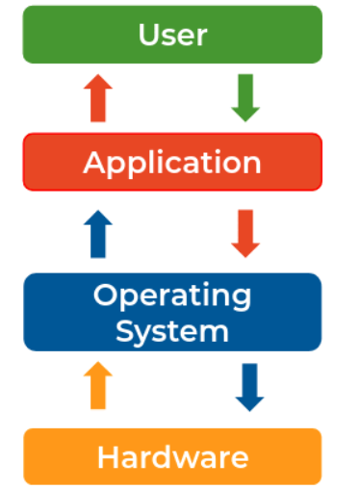
Introduction to Operating System
Operating System:
Operating System is an interface between hardware and software.

Slide 3
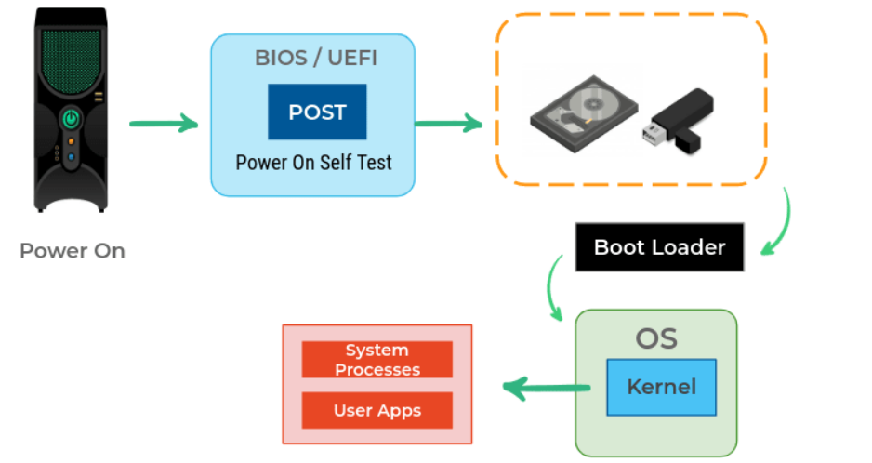
Boot Process:
Power on
Computers run a test to make sure all the hardware is working correctly this is called a Power On Self Test(POST).
Based on the BIOS configuration, a boot device(HDD, CD, or USB) that contains OS is selected for a program known as a boot loader which then loads the operating system.
Once OS gets loaded the essential part of OS Kernel is started and appropriately set for us to use.

Slide 4
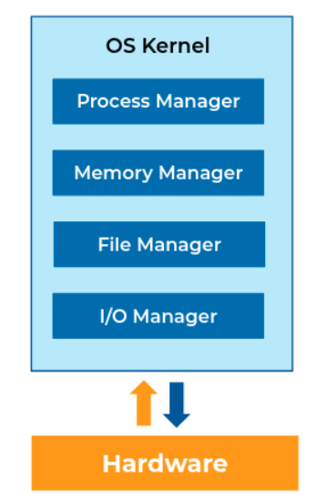
OS Kernel:
The Kernel is the core component of OS. As users, we don't interact with the kernel directly.
It interacts directly with the hardware.
It manages the hardware resources.

Slide 5
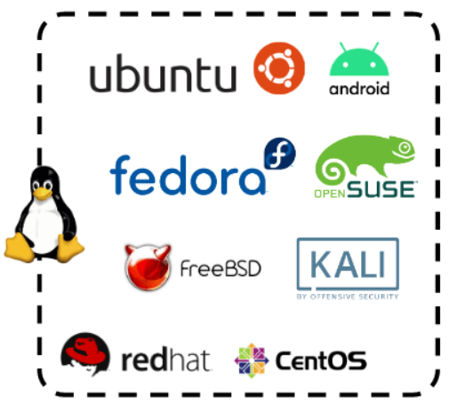
Linux Kernel:
Linux is a free and open-source OS Kernel developed by Linus Torvalds.
Operating Systems made from software based on Linux Kernel are referred to as Linux Distributions (or Linux Distros).

Slide 6
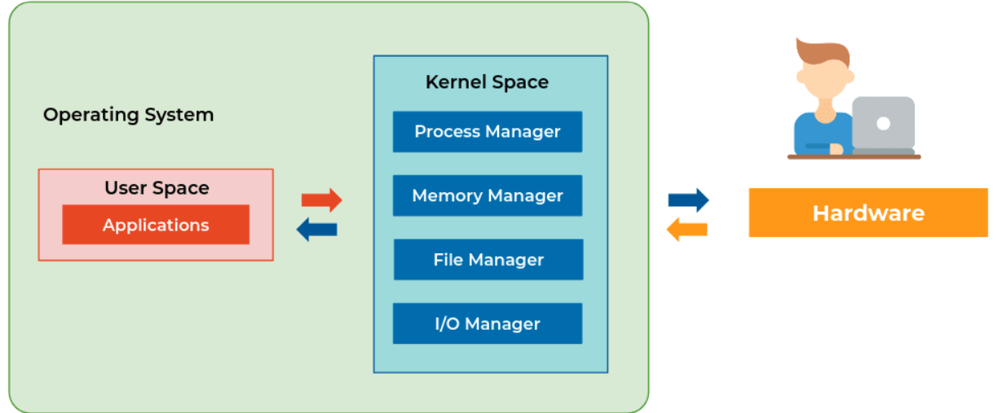
Components of OS:
Broadly we can categorize components of os are
Userspace
Kernel
All apps interact with the kernel. The kernel will interact with hardware

Slide 7
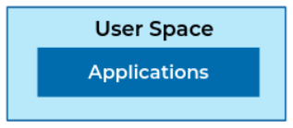
Userspace:
Userspace is everything outside the kernel.
Programs we interact with directly are part of Userspace which are Text Editors, Music Players, User Interfaces, etc.
Userspace can include some OS programs like the GUI etc.

Slide 8
Responsibilities of OS:
Abstraction:
Abstraction means hiding the unnecessary complex inner details and showing only the relevant features. Once the operating system is up we no longer deal with the internals. For example, consider a car driver he does need to know how the engine works in the car. he/she simply needs to know few things like steering, gear, and so on.
Operating System abstracts away the complex details of the underlying hardware.
It provides a common API to applications and services.
Thus, It simplifies development applications.
Resource Management:
Resource management is one of the important tasks for OS. power, memory, CPU, and so on are resources. For example, Mobile/laptop use multiple applications at the same time like chrome, music app, chat app. These applications required CPU, ram, GPU resources.
Operating System allocates hardware resources to applications in a fairway.
It makes efficient use of the limited resources.
It prevents improper use of computer resources.

Slide 9
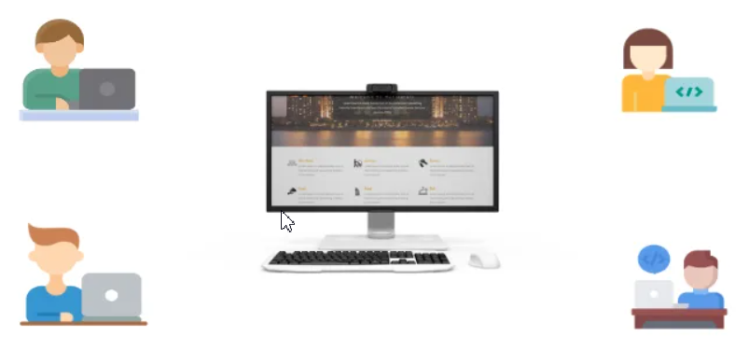
Isolation and Protection:
Operating System Provides a safe way for multiple applications to simultaneously run without interfering with each other.
It protects applications from each other. If one application fails Operating System ensures that it does not affect others.
Multi-User System:
In Laptops, computers, multiple users can access at the same time. Resource management between the apps used by each user is the responsibility of the operating system.

Slide 10
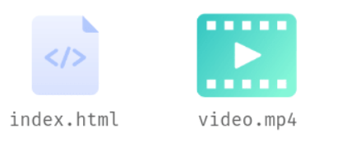
File and File Systems:
File:
A file is a collection of related information that is stored on the storage medium.
File Extensions:
Files may have an extension that is used to denote the type of file.
Programs open and operate files based on the file extension.
Image & Video Extensions: .jpeg, .png, .tiff, .mp4, .mov
Docs: .html, .js, .py, .docx, .txt

Slide 11
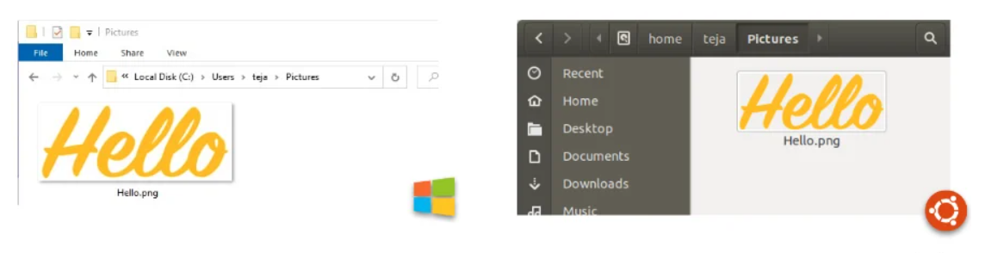
Files and Folders:
Usually, we organize files in folders and these folders are stored in other folders and this continues until we arrive at C:\ drive or some other drive in Windows and Root directory ( / )in Linux-based systems and macOS.

Slide 12
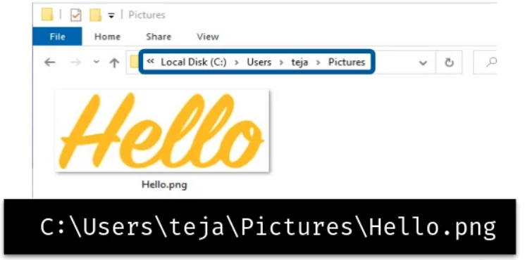
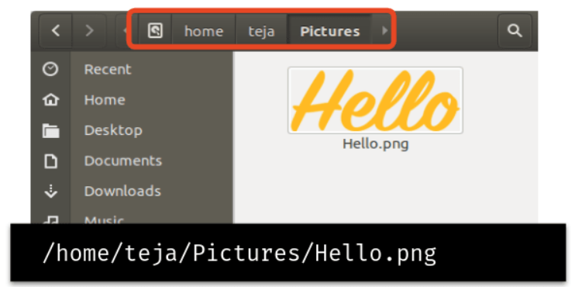
File Path:
The general form of the name of a file or directory specifies a unique location in a file system.
File path usually is folder names separated by slashes.

Slide 13
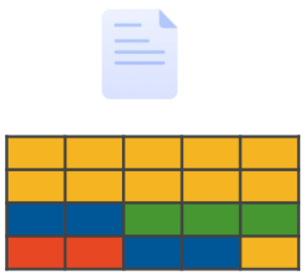
File and File Systems:
The kernel handles file storage on our machines. There are three main components to handling files on an OS.
File System
File Data
File Metadata
File Data:
The data of a file is broken down into pieces of data blocks of a fixed size before storing in a disk.
Default Block Size is 4 KB. So, the size occupied by a file on the disk will be in multiples of 4 KB.
Block storage improves faster handling of data because the data isn't stored on one long piece and it can be accessed quicker. It's also better for utilizing storage space.

Slide 14
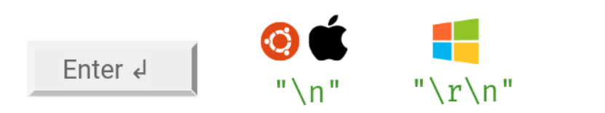
File Content
Though everything is stored in binary, files can be classified
Text Files
Non - Text Files
Text Files:
Consists of plain, unformatted words, letters, and punctuation (Unicode Characters) intended to be readable by humans. The text files can be opened by any text editor.
e.g. All Code files and plain text files
Line Endings:
The line ending character when Enter ↲ is typed is different in different Operating Systems.

Slide 15
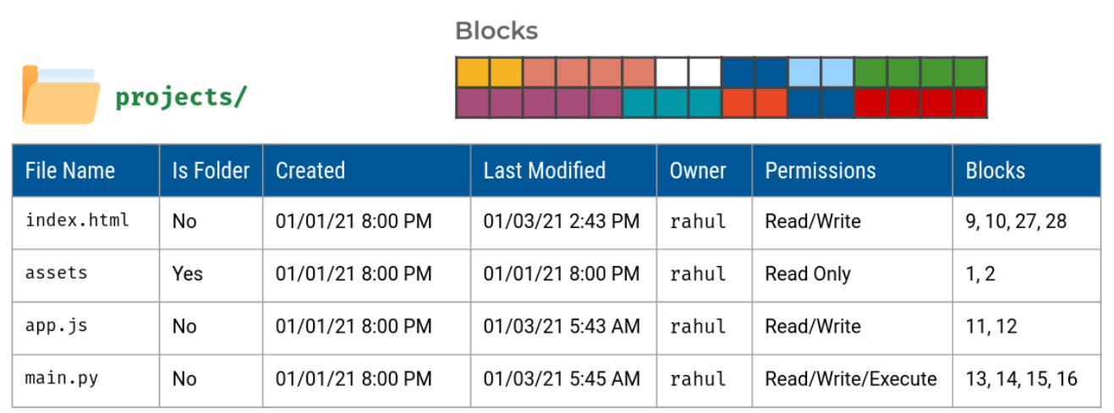
Non-Text Files:
Consists of non-textual data meant primarily to be read by applications that translate those content into something useful by humans.
Pictures, Audio, Video, Rich formatted text (Docs), etc.
File Metadata:
The file metadata contains the information about our file.
Owner of File
Permissions (Read, Write, Execute)
File Size
Creation Date Time
Last Modified Date Time

Slide 16
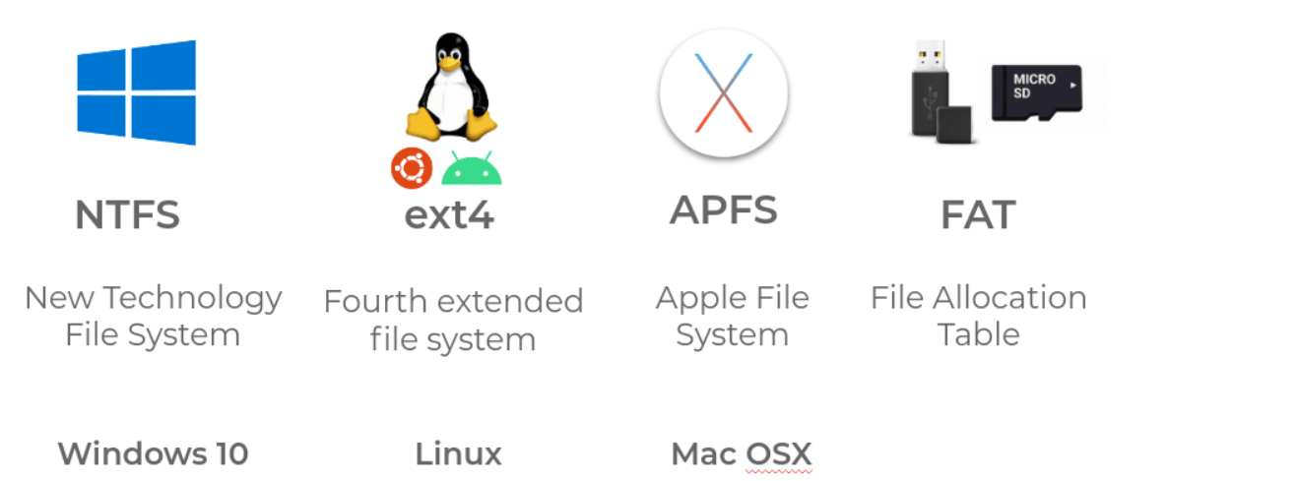
File Systems:
Responsible for managing files on the disk.
Provides a mechanism to store the data and access the file contents including data and programs.
Different file systems were developed for different use cases.
File System determine various aspects like
Limitations on File Size and File Names
Size occupied on the disk
Encryption
File Search
Backup & Versions

Slide 17
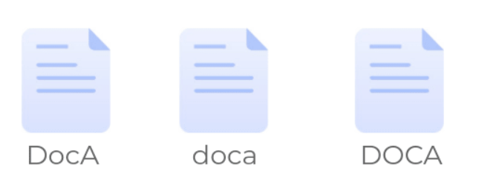
Case Sensitivity:
Each File System has its own rules, preferences, etc. Similarly, some File Systems are case sensitive. A case-sensitive file system distinguishes between uppercase and lowercase letters in file names and treats them as different files.
Ext4 (Linux) is case-sensitive.
NTFS (Windows), APFS (Mac), FAT are case-insensitive.

Slide 18
Key Takeaways
Operating System
Abstraction
Resource Management
User Space & Kernel Space
OS Kernel
File & File Systems
FAT, NTFS, EXT4, APFS
Case Sensitivity
File Metadata & Extension
File Paths
Text Files and Binary Files
Line Endings

